Slide 1

SESHADRI RAO GUDLAVALLERU ENGINEERING COLLEGE (An Autonomous Institute with Permanent Affiliation to JNTUK, Kakinada) Seshadri Rao Knowledge Village, Gudlavalleru - 521 356, Krishna District Department of Electronics and Communication Engineering
Detection and Measurement of Paddy leaf disease using SVM Classifier
Guide :
Dr. Ch. Balaswamy
Professor | M.Tech

Slide 2
A1 Batch Members
B. NAGA MANI - 19481A0417
ABDUL SATTAR -20485A0401
CH. JAIMINI SOWMYA – 19481A0444
G. RAVI KIRAN19481A0460

Slide 3
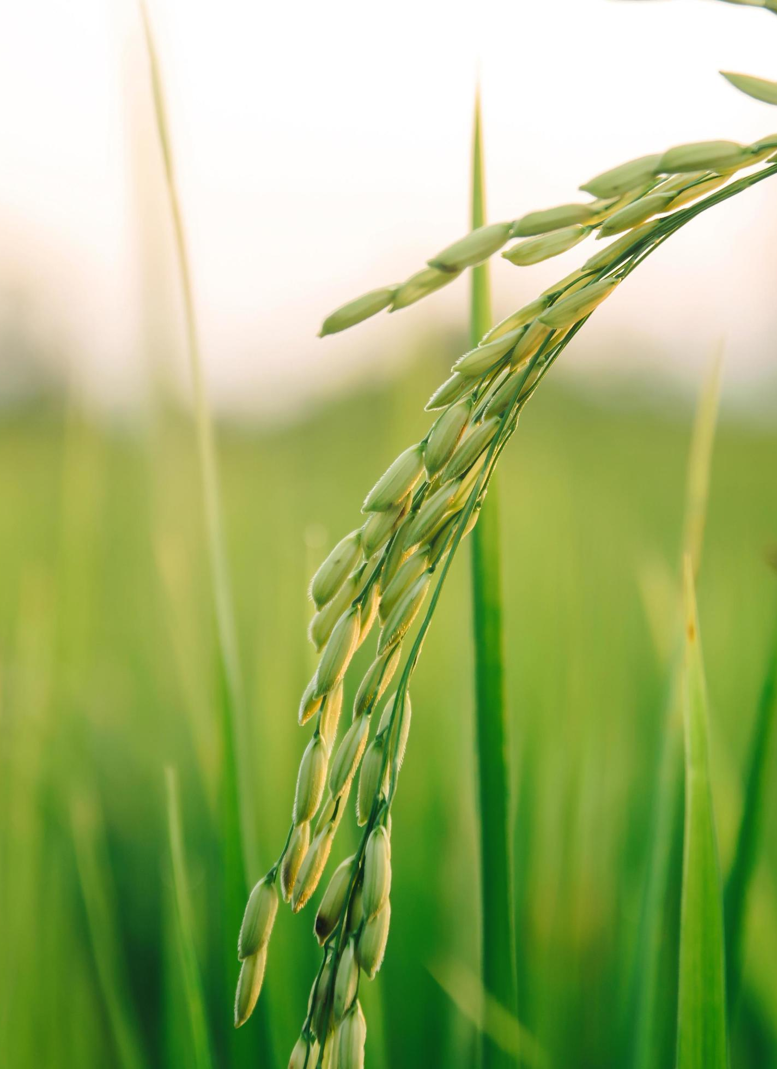
OBJECTIVE
The main objective of this research is to develop a data mining system to detect the paddy disease which are paddy Blast, Bacterial leaf Blight, Rice tungro disease, Sheath Blight.
The Methodology involves image acquisition preprocessing and segmentation analysis and classification of the paddy disease
Describes the specific symptoms and signs of rice disease
To know the art of plant disease diagnosis and the importance of correct diagnosis

Slide 4
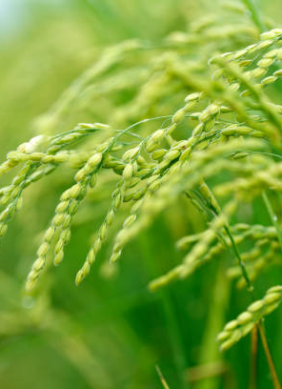
ABSTRACT
Rice is one of the staple foods of the world. But the production of rice is hampered by various kind of paddy diseases. One of the main diseases of paddy is leaf disease.
Generally, it is very time-consuming and laborious for farmers of remote areas to identify paddy leaf diseases due to unavailability of experts. Though experts are available in some areas, disease detection is performed by naked eye which causes inappropriate recognition sometimes.
An automated system is proposed for diagnosis three common paddy leaf diseases (Brown spot, Leaf blast, and Bacterial blight) and pesticides and/or fertilizers are advised according to the severity of the diseases.

Slide 5

SOFTWARE REQUIRED
MATLAB Software :
MATLAB is a programming platform designed specifically for engineers and scientists to analyze and design systems and products that transform our world.
MATLAB is a high-performance language for technical computing

Slide 6
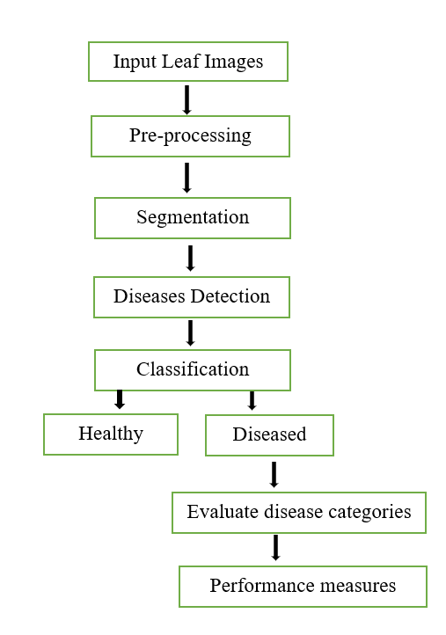
Flow chart :

Slide 7
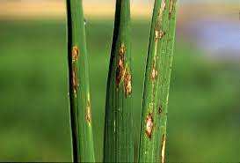
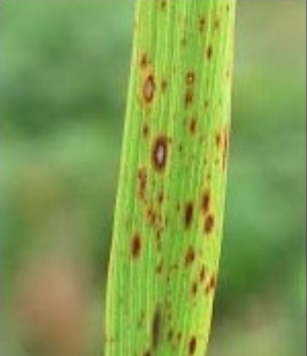
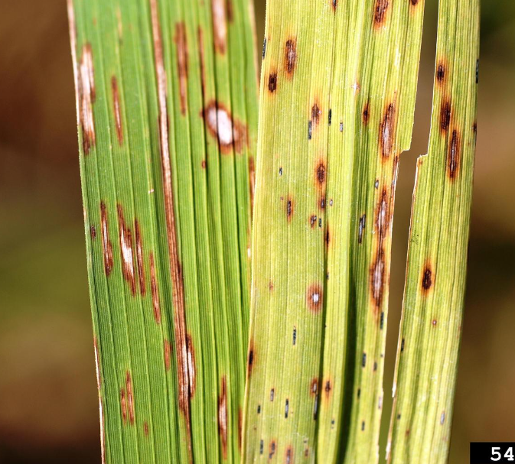
1.Input Leaf Images:
We have collected images of paddy leaves that are affected by different diseases like paddy blast, brownspot,narrow_bs etc. All those images are created as a file named leaf's. Some of the images are shown below.
Blast Brownspot Narrow_bs

Slide 8
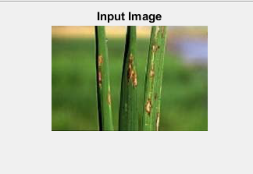
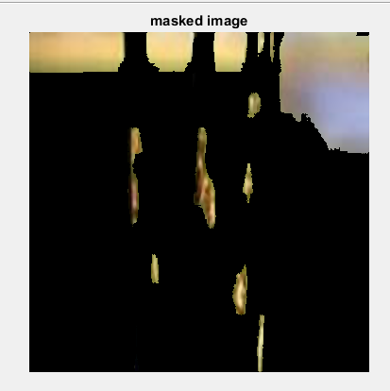
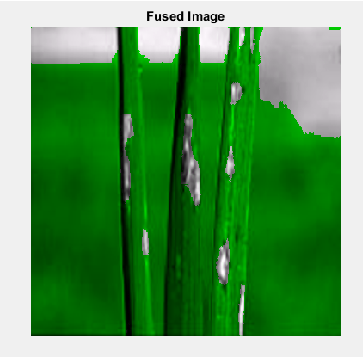
2.Preprocessing This involves the image enhancement that is to achieve high accuracy the RGB images are converted into grey scale Images. In this raw data get trained for further processing.
3.Segmentation
By using this technique, the noises of the image that affect the image quality are detected.
So both these techniques converts our input image into different images like masked image, Fused image, Grey image, Filtered image, Enhanced image, Segmented image, Histogram of an Image, Color information in order to detect disease easily. Here is the output of these two steps.
4. Disease Detection: Now it is all set to detect the leaf and can be able to classify whether it is healthy or diseased. If diseased its going to tell the name of the disease, symptoms of it and remedies to cure it.

Slide 9
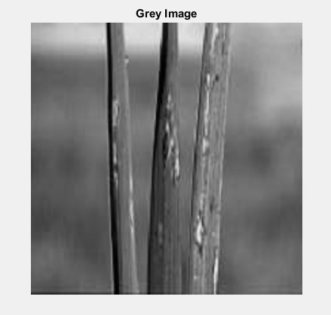
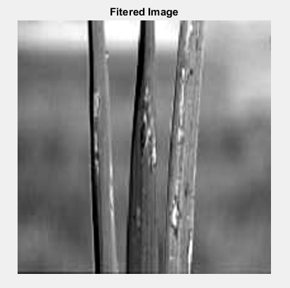
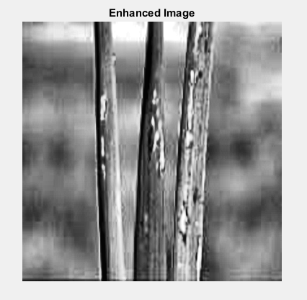
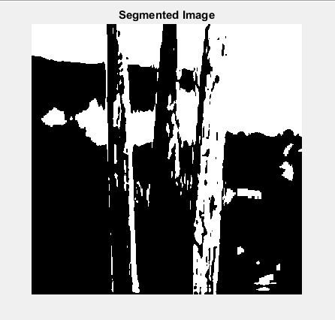
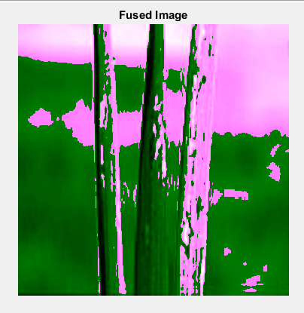
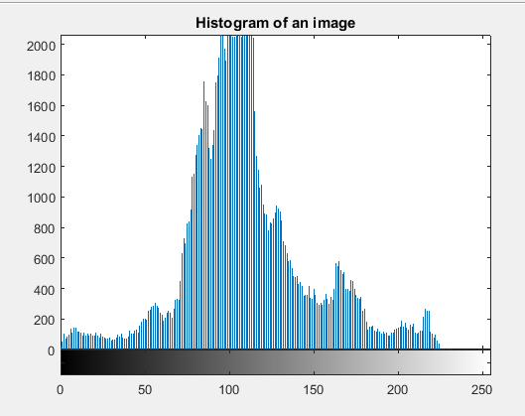
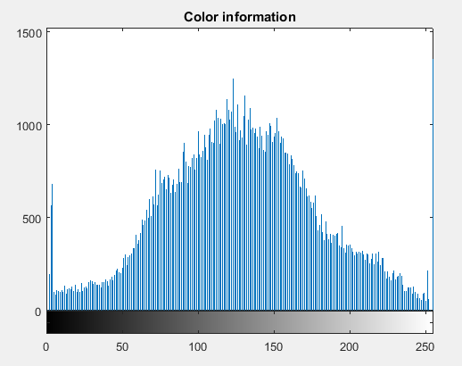

Slide 10
Implementation:
This is the overall explanation of our project and lets see the practical implementation. Now let us discuss how we run our code in MATLAB. Firstly we run the following code which is named as main_gui which results in main_gui.fig that contains two buttons, one is input button through which it takes leaf image and the other is information button which gives information like name of the disease, its symptoms and the remedies to cure it. To know the internal details that is how the image processing can be applied on input image can be known by running code named main.m.

Slide 11
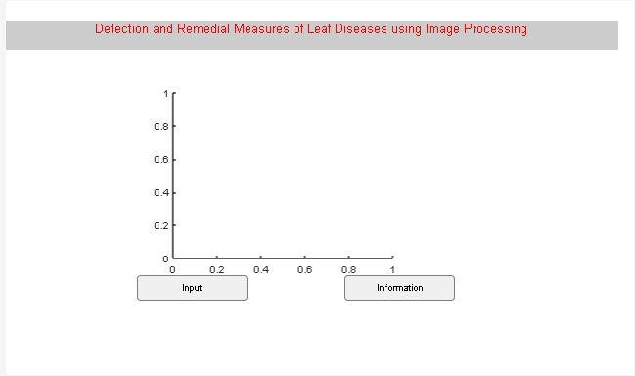
RESULT :
When we run the code named main_gui.m in MATLAB then main_gui.fig gets out as output ehich contains two buttons input and information

Slide 12
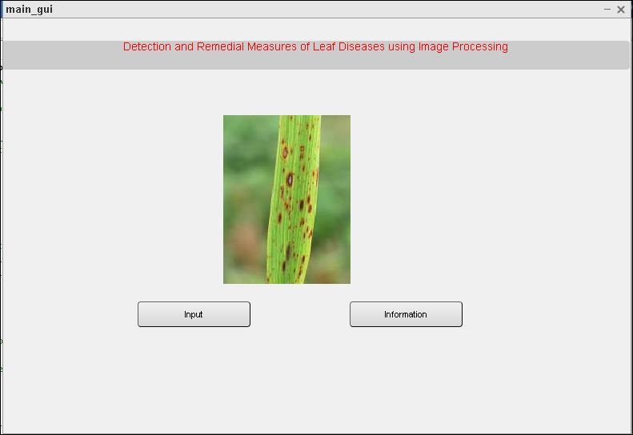
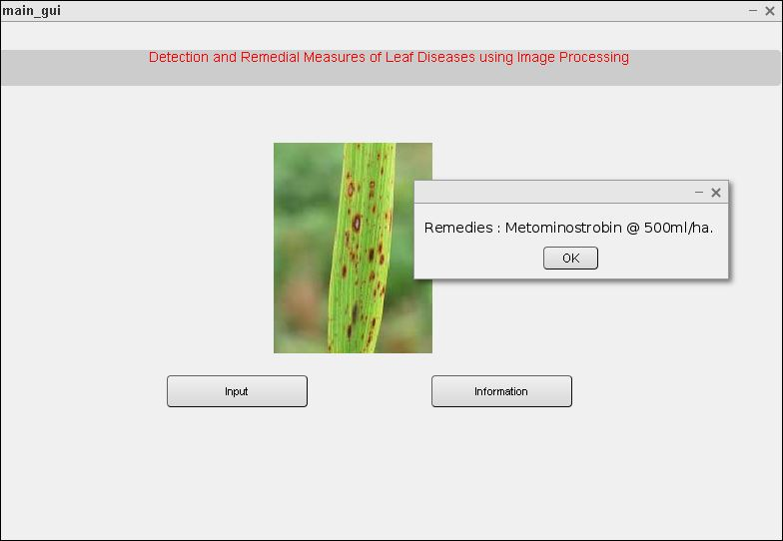
Selected Input Leaf Remedies

Slide 13
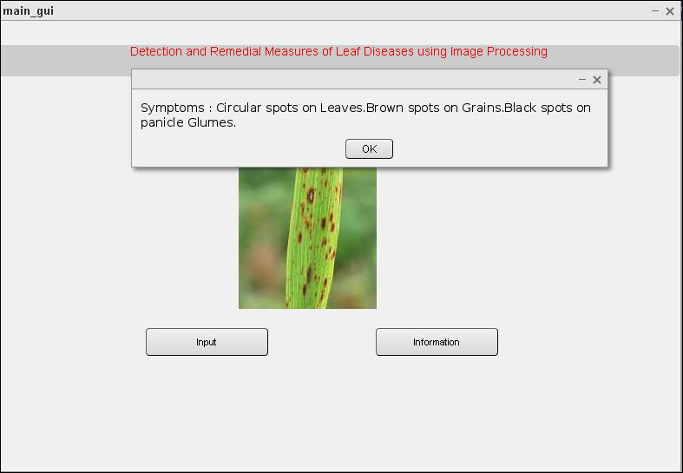
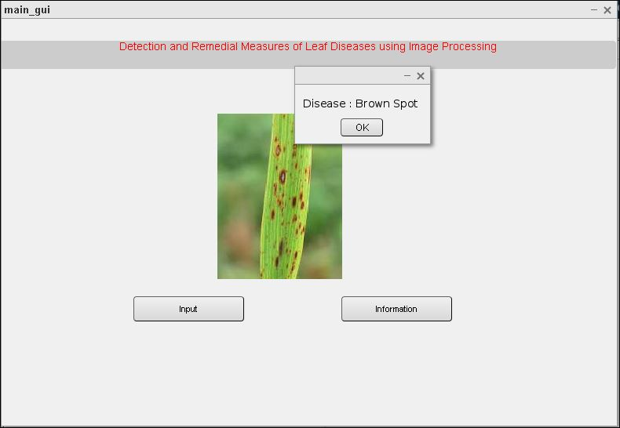
Symptoms Disease

Slide 14
Advantages:
1.Accuracy: SVM classifiers are known for their high accuracy in classifying data. By using an SVM classifier for detecting and measuring paddy leaf disease, one can achieve high accuracy in identifying the disease accurately.
2.Speed: SVM classifiers are known for their fast processing speed, which makes them ideal for real-time detection and measurement of paddy leaf disease.
3.Automation: The use of an SVM classifier for detecting and measuring paddy leaf disease can automate the process, reducing the need for manual intervention and increasing the efficiency of the process.
4.Early Detection: Early detection of paddy leaf disease is crucial in preventing its spread and minimizing crop losses. The use of SVM classifiers can detect the disease at an early stage, allowing for timely intervention.
5.Cost-Effective: The use of an SVM classifier for detecting and measuring paddy leaf disease is cost-effective, as it eliminates the need for expensive manual labour and reduces the risk of human error.

Slide 15
Disadvantages:
1.Complexity: The SVM classifier can be complex, requiring significant computational resources and time to train and optimize.
2.Limited scalability: The SVM classifier can have limited scalability, meaning that it may not be suitable for large-scale datasets.

Slide 16

REFERENCES
International Research Journal of Engineering and Technology (IRJET) Volume: 09 Issue:08 | Aug 2022 PADDY CROP DISEASE DETECTION USING SVM ANDCNN ALGORITHM
T. Gupta, ”Plant leaf disease analysis using image processing technique with modified SVMCS classifier,” Int. J. Eng. Manag. Techno, no. 5, pp. 11-17, 2017.
Shrivastava, V. K., & Pradhan, M. K. (2021). Rice plant disease classification using colour features: a machine learning paradigm. Journal of Plant Pathology

Slide 17
THANK YOU

